Slide 1


 | SILIGURI INSTITUTE OF TECHNOLOGY DEPARTMENT OF ELECTRICAL ENGINEERING STOCK PRICE PREDICTION Industrial Project Submitted in Partial Fulfillment of the Requirements for the degree of BACHELOR OF TECHNOLOGY IN ELECTRICAL ENGINEERING By Abinab Nag (11901620011) Sonam Dargey Bhutia (11901620003) Tsheringma Tamang (11901621016) Laden Ghising (11901621025)

Slide 2

GOAL OF THE PROJECT
Stock market is a place where buying and selling of shares happen for publicly listed companies. Stock exchange is the mediator that allows buying and selling of shares. Stock market prediction helps to determine the future value of company stock and other financial instruments traded on an exchange.
By using supervised machine learning we predict our stock market prediction.

Slide 3
SPECIFIC REQUIREMENTS
SOFTWARE :
Operating System
Platform - Window, Linux
Operating system - Window, Linux
Technology – python
Scripting language – Python
Web Browser
Internet Explorer 7
Google Chrome
Mozila Firefox
All web browser i.e. supported by python
HARDWARE :
CPU core to dual core
SSD – 256 GB
RAM – 2 GB (minimum)

Slide 4
INTRODUCTION
Stock market prediction is the act of trying to determine the future value of a company stock or other financial instrument traded on an exchange. The successful prediction of a stock’s future price could yield significant profit. The efficient market hypothesis suggests that stock prices reflect all currently available information and any price changes that are not based on newly revealed information thus are inherently unpredictable.
IMPORTANCE
Helps companies to raise capital
Helps create personal wealth
Serves as an indicator of the state of the company
Helps to increase investment

Slide 5
OBJECTIVE
To examine a number of different forecasting techniques to predict future stock returns.
To determine the values that particular stock will have in near future.
To provide a platform where stock movements of the major companies are displayed.
MACHINE LEARNING
Machine Learning is a type of Artificial Intelligence(AI) that provides computers with the ability to learn without being explicitly programmed. Machine Learning focuses on the development of computer programs that can change when exposed to new data.
Python community has developed many modules to help programmers implement machine learning.
MODULES
- NumPy
- Matplotlib
- Pandas
- Tensorflow

Slide 6
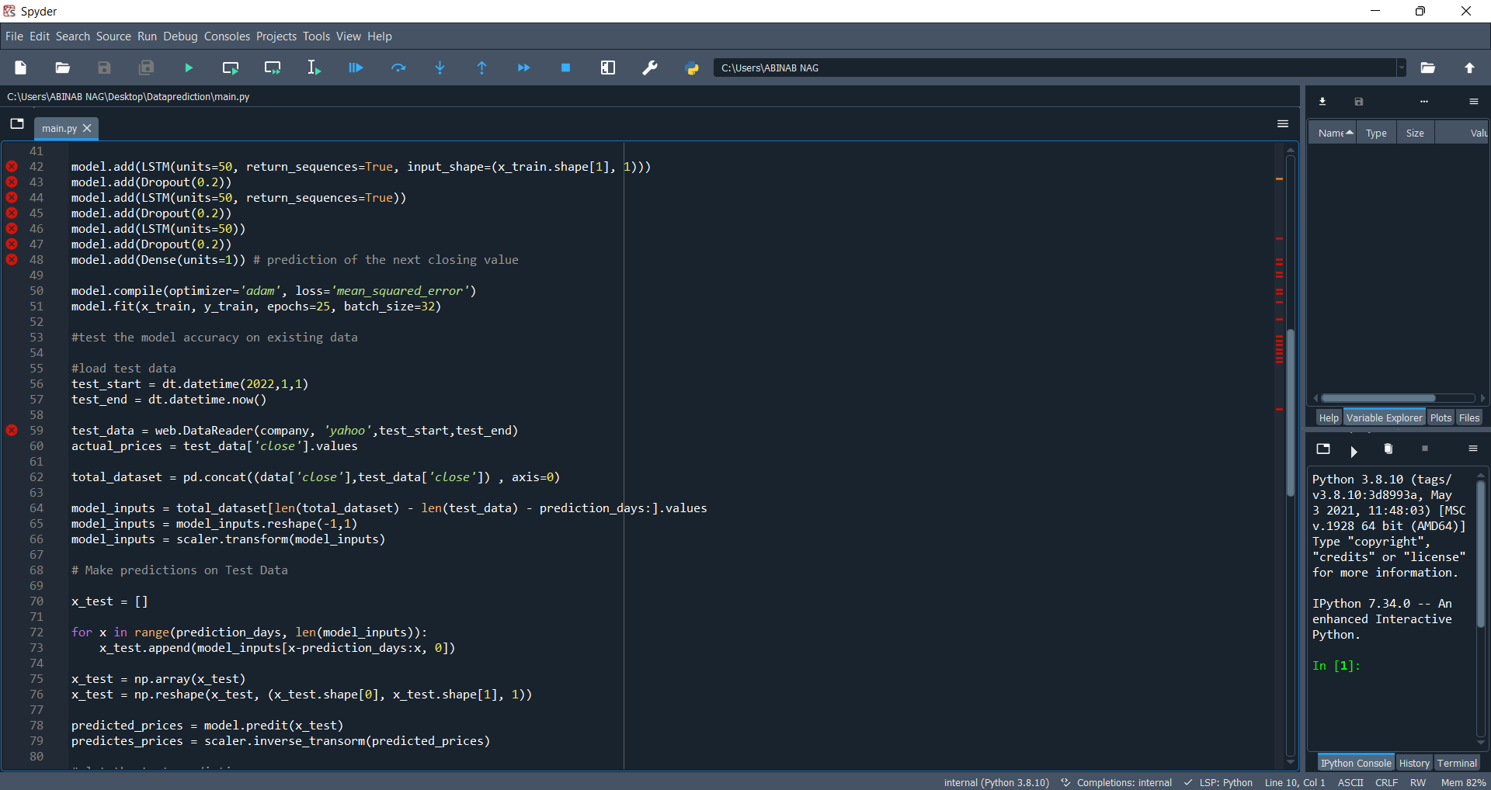
SNAPSHOTS

Slide 7
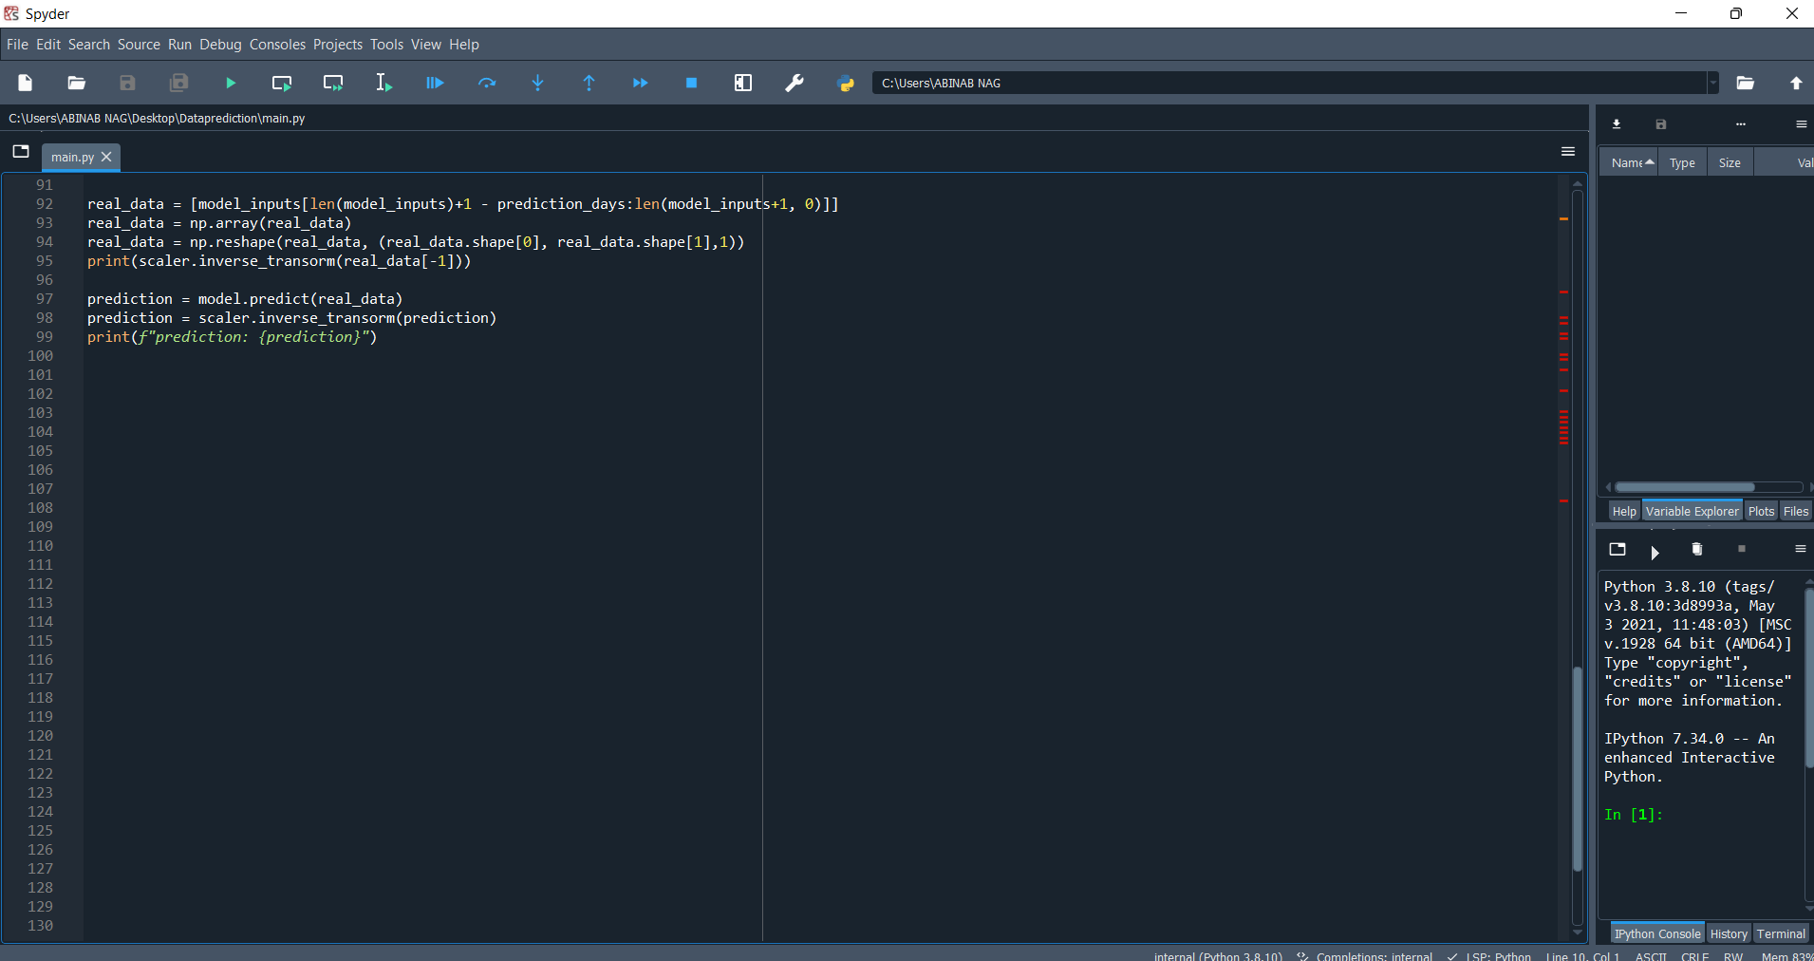
SNAPSHOTS

Slide 8
CONCLUSION
Use of recently introduced machine learning techniques in the prediction of stocks have yielded promising results and thereby marked the use of them in profitable exchange schemes. It has led to the conclusion that it is possible to predict stock market with more accuracy and efficiency using machine learning techniques. The stock market plays a remarkable role in our daily lives. It is significant factor in a country’s GDP growth. In the future, the stock market prediction system can be further improved by utilizing a much bigger dataset than the one being utilized currently. This would help to increase the accuracy of our prediction models.
Furthermore, other models of Machine Learning could also be studied to check for the accuracy rate resulted by them.

Slide 9
FUTURE SCOPE
Future scope of this project will involve adding more parameters and factors like the financial ratios, multiple instances, etc. The more the parameters are taken into account more will be the accuracy. The algorithms can also be applied for analyzing the contents of public comments and thus determine patterns/relationships between the customer and the corporate employee. The use of traditional algorithms and data mining techniques can also help predict the corporation performance structure as a whole.
In the future, we plan to integrate neural network with some other techniques such as genetic algorithm or fuzzy logic. Genetic algorithm can be used to identify optimal network architecture and training parameters. Fuzzy logic provides the ability to account for some uncertainty produced by the neural network predictions. Their uses in conjunction with neural network could provide an improvement for stock market prediction.

Slide 10
REFERENCES
[1]. Stock market forecasting research based on Neural Network and Pattern Matching LIN Qian Yu.
[2]. Performance Analysis of Indian Stock Market Index using Neural Network Time Series Model D. ASHOK KUMAR, Department of Computer Science Government Arts College Tiruchirappalli, India-620 022.

Slide 11
THANK YOU

